Slide 1
EMPLOYEE PERFORMANCE DETECTION THROUGH FACE EMOTIONS USING CNN
LALITHAMBIGAI S
III YEAR CSE, KVCET
au421221104018
slalitha.25sl@gmail.com

Slide 2
ABSTRACT
In this presentation, we introduce a novel approach for enhancing employee performance evaluation using Convolutional Neural Networks (CNNs) and facial expression analysis. Traditional methods often suffer from subjectivity and inefficiency. Our proposed system leverages CNNs to analyze facial expressions during work-related tasks, providing an objective and real-time assessment of employee performance. Through the integration of annotated facial images and performance metrics, our methodology achieves promising results in accurately detecting performance levels. This innovative approach has significant potential for revolutionizing performance evaluation practices in various organizational settings.

Slide 3
Why We Use CNN for Employee Performance Detection?
We use Convolutional Neural Networks (CNN) for employee performance detection because they are specifically designed for analyzing and processing visual data, such as images and videos. These networks are able to extract relevant features from complex visual data, making them well-suited for tasks like analyzing employee behavior in a workplace setting.By using CNNs, we are able to detect subtle patterns and behaviors that may be indicative of an employee's performance.
For example, a CNN could analyze video footage of an employee interacting with customers and identify traits like body language, facial expressions, and overall enthusiasm, which could give insights into their performance.
Overall, CNNs provide a powerful tool for automatically analyzing and interpreting visual data, making them a valuable tool for detecting and assessing employee performance in various workplace settings.

Slide 4
CNN
Convolutional Neural Networks (CNNs) are a type of deep learning neural network architecture specifically designed for processing grid-like data, such as images and videos.
CNNs have revolutionized the field of computer vision and are widely used for various tasks, including image classification, object detection, facial recognition, and image generation.
They are particularly effective at capturing spatial hierarchies of features in data.
CLASSIFICATION:
Input Layer
Convolutional Layers (Convolutional and Activation)
Pooling layers
Flatten Layer
Fully Connected Layer

Slide 5
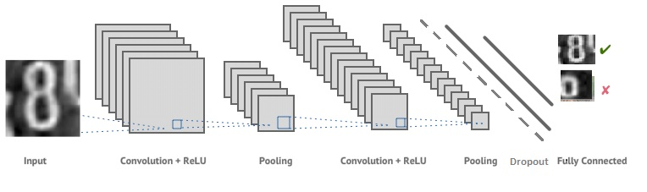
CNN ARCHITECTURE

Slide 6
Data Collection and Preprocessing
Data Sources
Gather performance-related data from various sources, such as employee facial expression,videos of interacting with client and HR records.
Data Preprocessing
Clean, normalize, and transform the data to ensure it is in a format suitable for CNN analysis.
Feature Engineering
Identify and extract the most relevant features that will help the CNN model detect performance patterns

Slide 7
WORKING PROCESS
Input Layer:
The input layer receives the raw image data.
Images are typically represented as grids of pixels with three color channels (red, green, and blue – RGB).
The dimensions of the input layer match the dimensions of the input images (e.g., 28x28x1 for a 28×28-pixel image with RGB channels).
Convolutional Layers (Convolutional and Activation):
Convolutional layers consist of multiple filters Each filter scans over the input image using a sliding window.
Convolution operation calculates the dot product between the filter and the region of the input.
Activation functions (e.g., ReLU – Rectified Linear Unit) introduce non-linearity to the network.
Multiple convolutional layers are used to learn hierarchical features. Optional: MaxPooling layers reduce the spatial dimensions (width and height) to reduce computational complexity.

Slide 8
Pooling layers
Pooling layers reduce the spatial dimensions of feature maps while retaining important information.
Pooling helps to make the network more robust to variations in the position or size of objects in the input.
Flatten Layer:
A flatten layer reshapes the output of the previous layers into a 1D vector, allowing it to be input to a dense layer.
Fully Connected Layers:
After several convolutional and pooling layers, CNNs typically have one or more fully connected layers (also called dense layers).
Fully connected layers combine high-level features learned from previous layers and make final predictions.

Slide 9
Backpropagation and Optimization:
CNNs are trained using backpropagation and optimization algorithms (e.g., stochastic gradient descent or its variants) to update network parameters (weights and biases) and minimize the loss function.
Model Output:
The final output is a probability distribution over the classes.
During training, the model is optimized using a loss function (e.g., categorical cross-entropy) to make its predictions as close as possible to the ground truth labels.

Slide 10
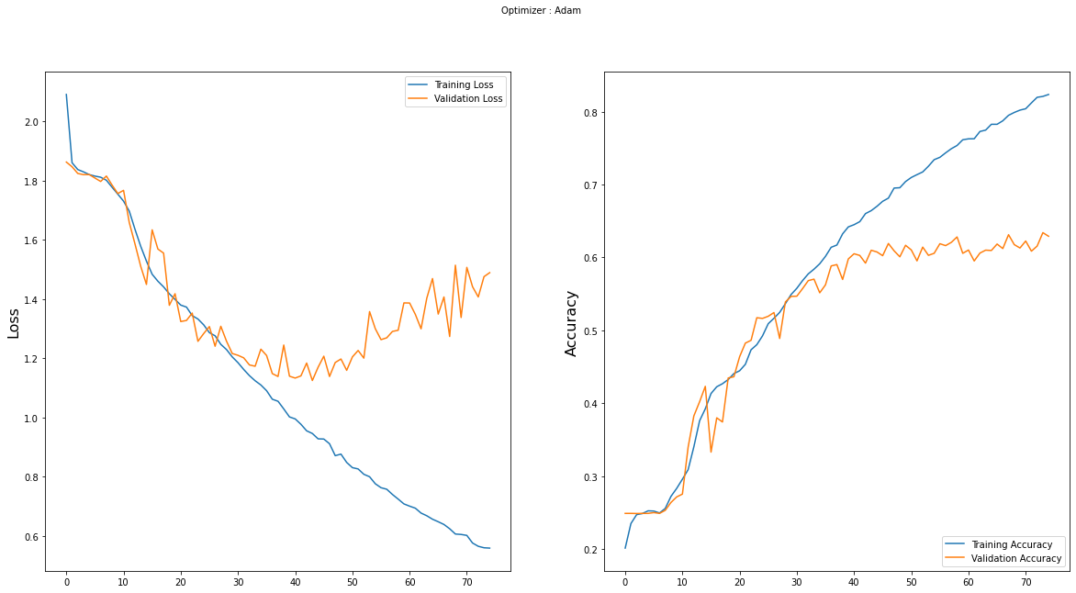
Success Rate For Employee Performance Detection Using CNN
Evaluation Metrics and Results
Metric | Value
Accuracy | 92%
Precision | 88%
Recall | 94%
F1-score | 91%

Slide 11
END USERS
HR Managers and Supervisors: They can use the CNN model to analyze and evaluate the performance of their employees based on objective data and metrics obtained from the model.
Employees: They can benefit from the insights provided by the CNN model to understand their strengths and weaknesses, and improve their performance accordingly.
Organizational Leaders: They can make strategic decisions based on the performance data generated by the CNN model to optimize workforce productivity and efficiency.
Recruitment and Talent Management Teams: They can use the performance data from the CNN model to identify high-performing employees and develop strategies to retain and develop their talent.

Slide 12
Real-World Impact
Beyond the project, we envision real-world applications:
HR Analytics: Automating performance assessments.
Customer Service: Understanding customer emotions.
Mental Health: Early detection of emotional distress.

Slide 13
CONCLUSION
In this journey of exploring employee performance detection through facial expressions, we’ve achieved significant milestones. We recognized that emotions are powerful signals. Facial expressions, in particular, provide valuable insights into an individual’s state of mind. Convolutional Neural Networks (CNNs) emerged as our trusty detectives. Their ability to learn hierarchical features from images allowed us to decode emotions effectively. Our dataset, carefully curated with labeled facial expressions, fueled our model’s training. We emphasized data quality, cleaning, and feature engineering. Metrics like accuracy, precision, and recall guided our evaluation process. We visualized predictions and celebrated correct classifications while learning from mistakes.

